Slide 1
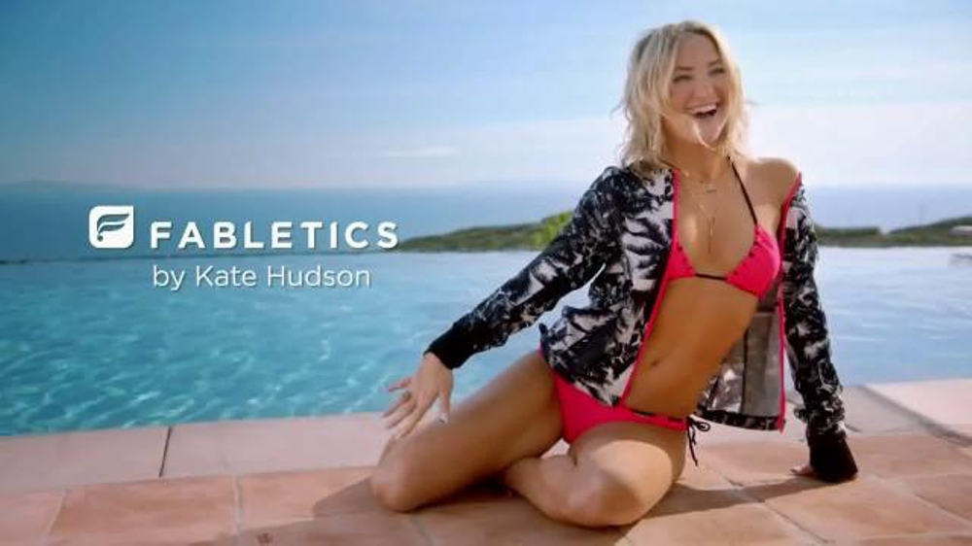
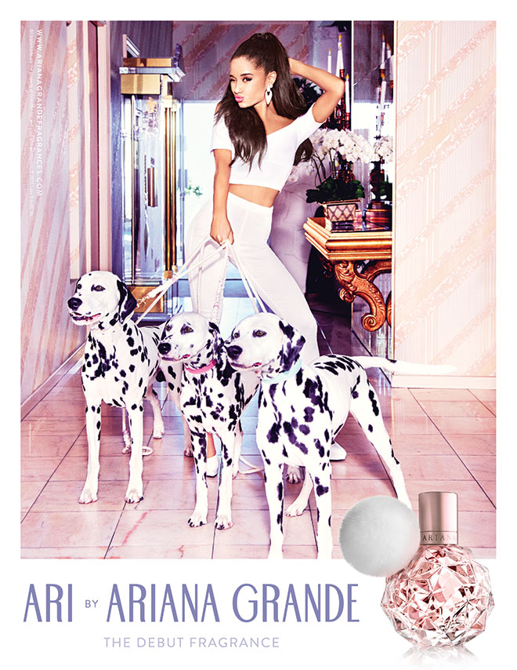






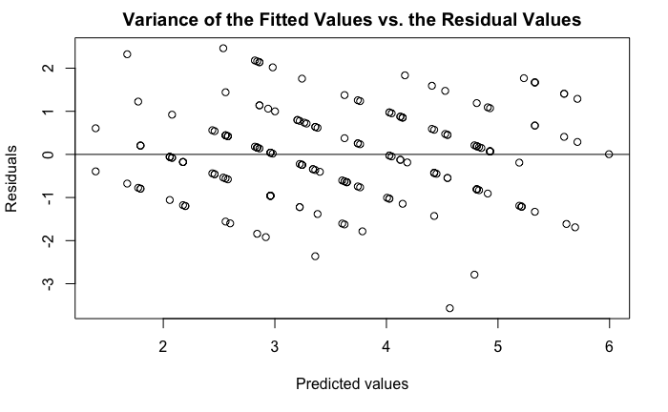
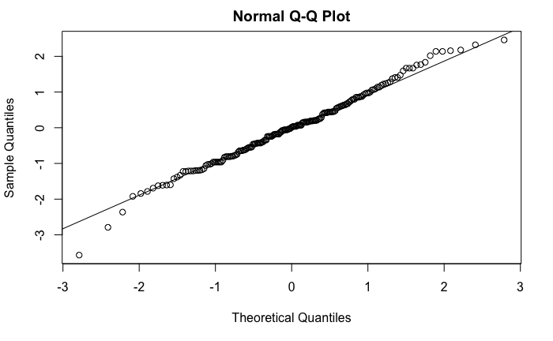
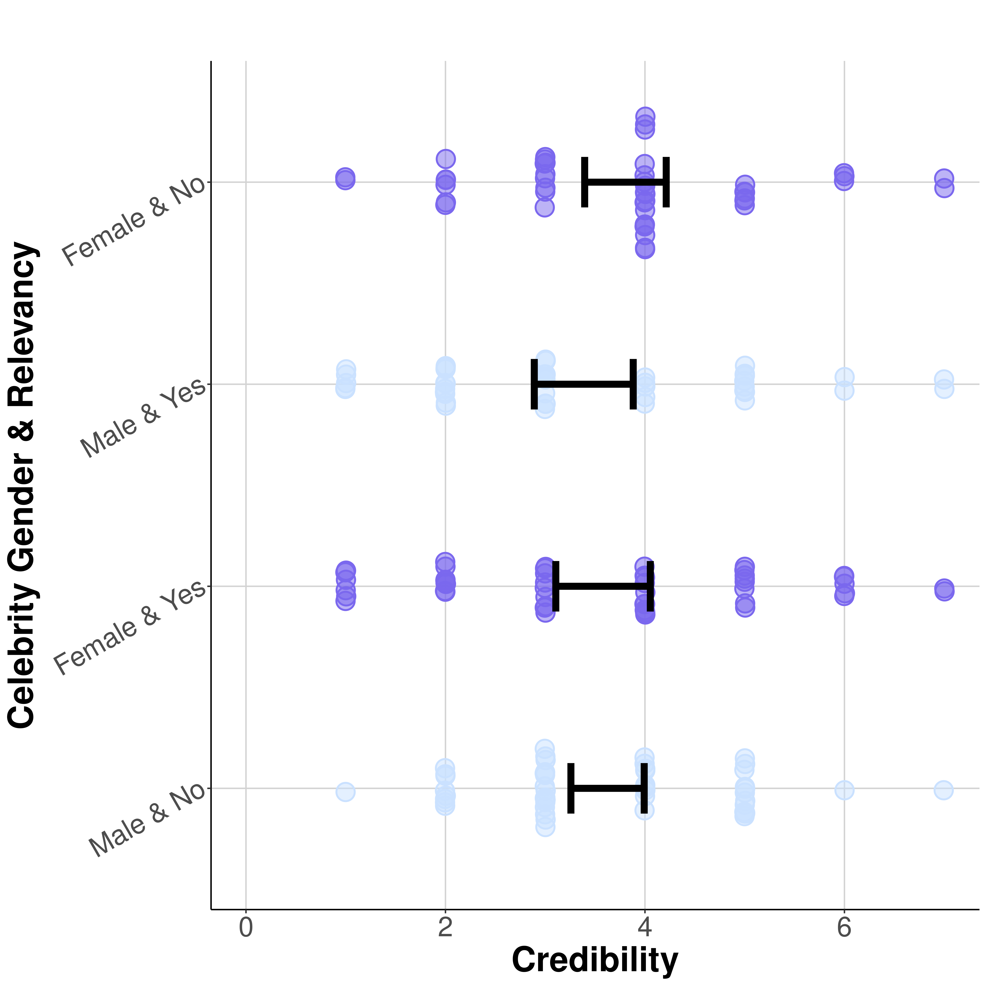
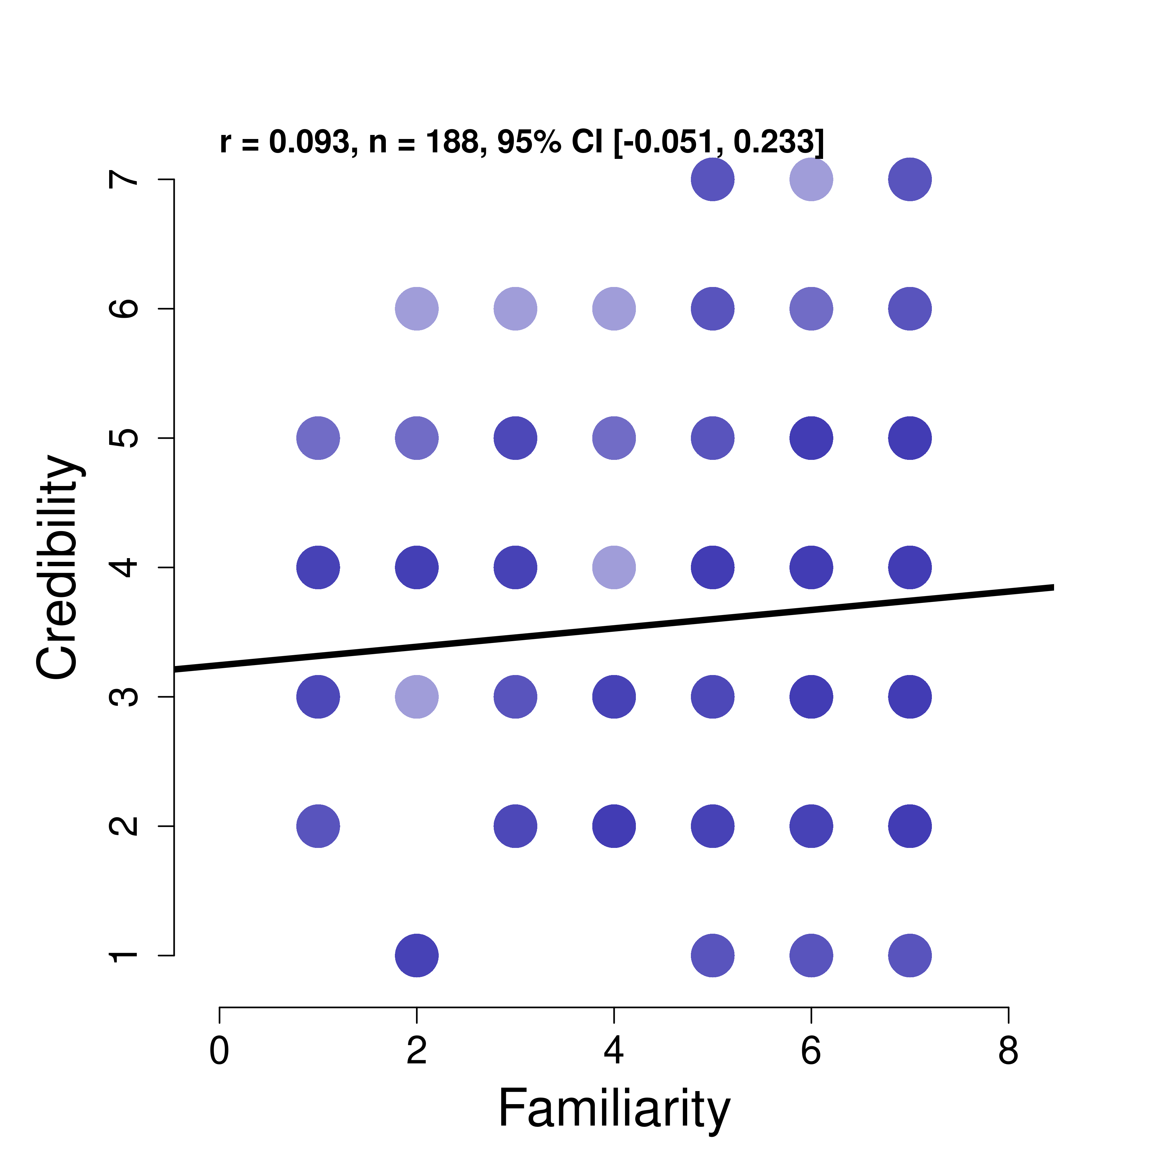
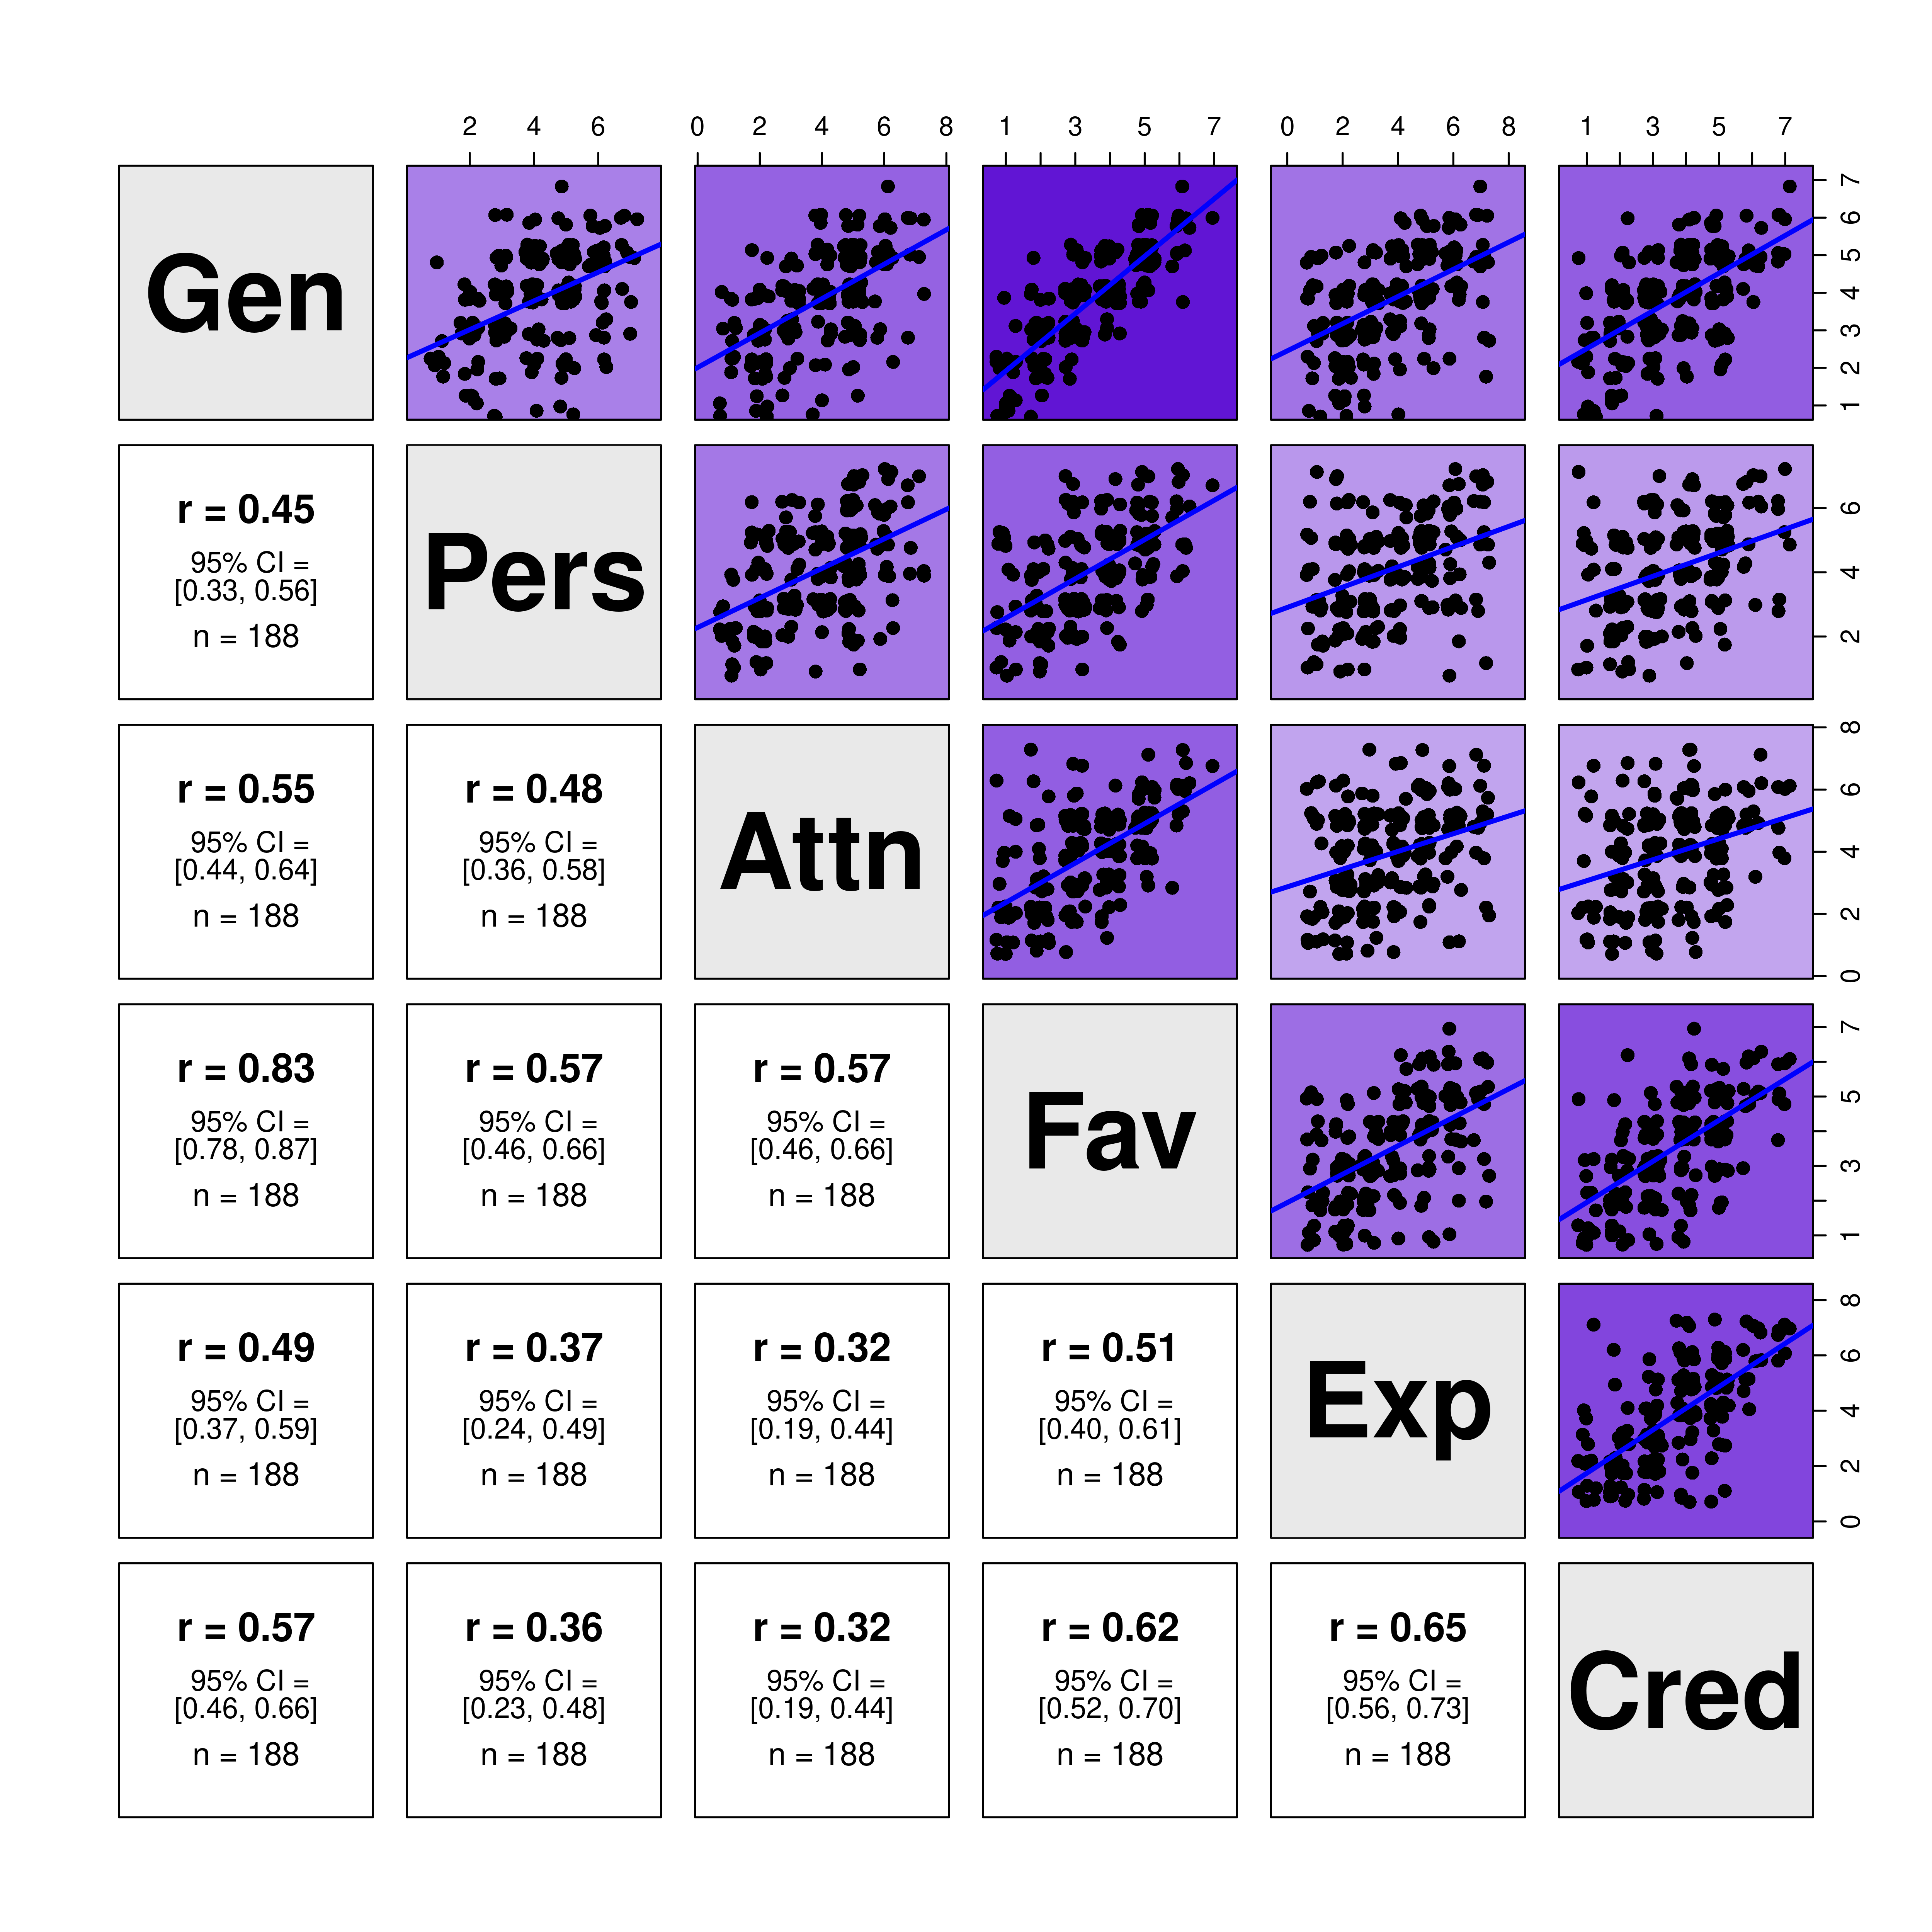
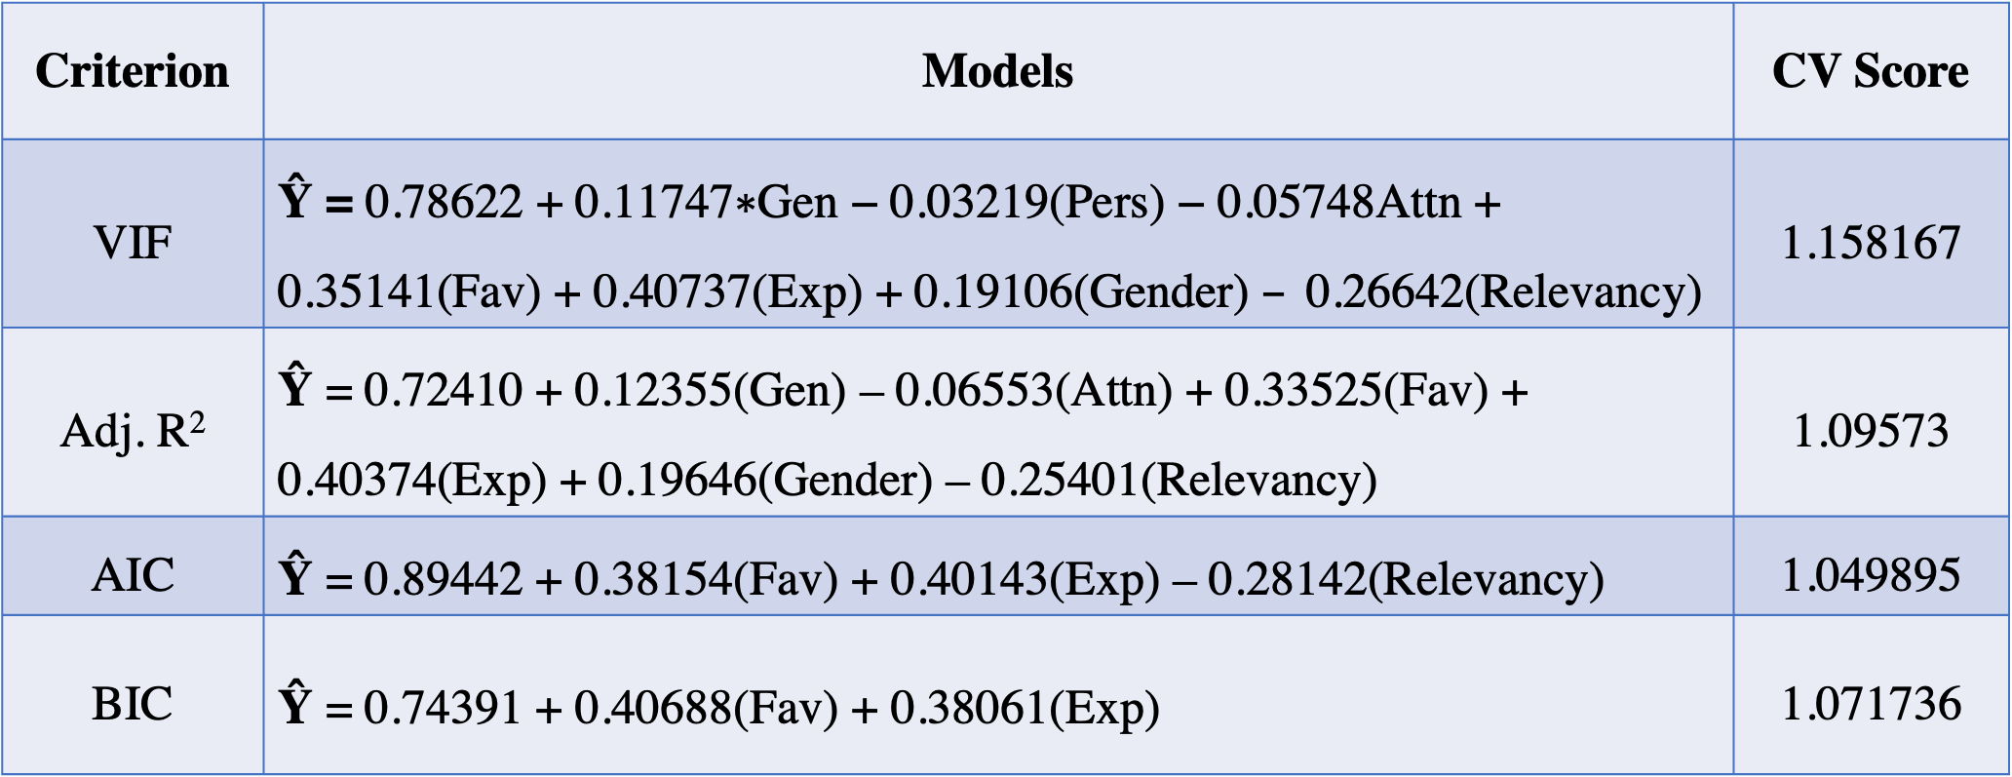
Celebrities: What makes them Credible?
Diana Hernandez
About the Project
Advertisements Utilized
Analysis
The capstone project is a continuation of a research project that includes contributions from students in PSYC 310R, Research Methods in Social Psychology. In this study, we were interested in what makes advertisements persuasive, in particular, what aspects of the communicator are important. This study was based on the match-up hypothesis, which suggests that models are more effective when they are relevant for the endorsed product compared to when they are less relevant for the product. More specifically, we were focusing on how a celebrity’s expertise may play a role in the effectiveness of the advertisement for the product. Participants were shown 5 adds. Two of these ads had a celebrity in them. The other three adds did not have a celebrity where they served as filler ads. We were only interested in participant’s responses to the celebrity ads.
In my continuation of the research project, I wanted to explore what factors make a celebrity a credible communicator. My response of interest is the celebrity’s credibility. I will be using the following predictors in my analysis: Gender, Relevancy, Gen, Pers, Attn, Fav, and Exp, to identify what components make an ad effective and deem the communicator of the ad as credible. My continuation of the project includes regression models and diagrams to demonstrate my findings.
The data was collected from a population of Wellesley College students where they performed their task via a survey on Qualtrics
Criterion | Models | CV Score
VIF | $\text{Ŷ}$ $\text{=} \text{0.78622}\text{ +} \text{0.11747}\text{∗}\text{Gen}\text{ − 0.03219}\text{(}\text{Pers}\text{) − 0.05748}\text{Attn}\text{ + 0.35141(}\text{Fav}\text{) + 0.40737(}\text{Exp}\text{) + 0.19106(}\text{Gender}\text{) }–\text{ 0.26642(}\text{Relevancy}\text{) }$ | 1.158167
Adj. R² | $\text{Ŷ}$ = 0.72410 + 0.12355(Gen) – 0.06553(Attn) + 0.33525(Fav) + 0.40374(Exp) + 0.19646(Gender) – 0.25401(Relevancy) | 1.09573
AIC | $\text{Ŷ}$ = 0.89442 + 0.38154(Fav) + 0.40143(Exp) – 0.28142(Relevancy) | 1.049895
BIC | $\text{Ŷ}$ = 0.74391 + 0.40688(Fav) + 0.38061(Exp) | 1.071736
Female Celebrity and Relevant
Female Celebrity and Not Relevant
The selection of the final model is based on the model with a low CV value as it indicates a stronger predictive power on independent observations. Thus, there is preference for the model obtained under the AIC criterion as it has the smallest cross-validation score.
Final Model Diagnosis
Variables
The following details the meaning of each variable of interest:
Gender: Gender of the celebrity
Relevancy: Is the celebrity advertising their own product?
Gen: What is your general impression of the ad?
Pers: How effective do you think this ad is in persuading potential consumers?
Attn : How much did this ad draw your attention?
Fav: Do you judge this ad favorably?
Exp: To what extent do you think the person/people in this ad have expertise in the ad’s product category?
Cred: To what extent do you find the person/people in this ad to be (a) credible and trustworthy communicator(s)?
Gender and Relevancy are categorical variables. The levels for Gender were defined as Female or Male. The levels for relevancy were defined as 0 and 1 with 0 meaning ”No” and 1 meaning “Yes.”
Male Celebrity and Relevant
Male Celebrity and Not Relevant
Plots
Relationship between Celebrity Credibility, Gender, and Relevancy to Ad
Figure 3
Figure 4
In order to consider the AIC model as the final model, further model diagnosis was conducted. Figure 3 and 4 were produced in order to identify any violations of multiple linear regression assumptions. Figure 3 does not violate the constant variance assumption as the distribution of the residuals is normally distributed across the abline. Although this pattern may seem unusual from typical linear regression models, the ranked-scaled data was treated as quantitative data. Therefore, it is not unusual to see the pattern displayed on figure 3. Figure 4 suggests that the normality assumption was not violated as most of the distribution of residuals are within the normal probability line.
Questions of Interest
Discussion
What attributes makes a celebrity in an ad an effective communicator? What is the impact of relevancy and gender to estimate credibility among an audience of Wellesley College undergraduates? Does relevancy and gender have no impact, a small impact, or a major impact on a celebrity’s credibility?
Relationship between Familiarity of a Celebrity and a Celebrity’s Credibility
Figure 1: This plot demonstrates the relationship of our response variable, Credibility, to a Celebrity’s gender and relevancy to the product. The confidence intervals in each group hints gender and relevancy as a nonsignificant factor in determining how credible a celebrity is as communicator.
Correlation Matrix of Quantitative
Hypothesis
Advertisements in which celebrities sell their own products are more effective than advertisements in which celebrities sell products they are hired for. Advertisements with female celebrities branding their own products will have the greatest effectiveness, followed by advertisements with male celebrities branding their own products.
Figure 5
The final model suggests that variables Fav, Exp, and Relevancy are strong predictors in measuring a celebrity’s credibility. In other words, how relevant a product is to the celebrity, how favorable we deem the ad, and a celebrity’s expertise on a product category are important factors to take into consideration in determining a celebrity’s credibility. Although this seems promising, figure 1 suggests otherwise as it demonstrates how relevancy does not have a major effect on a celebrity’s credibility. In other words, the confidence intervals demonstrated in plot 1 are not significantly different nor higher than the confidence intervals depicted under the not relevant categories. Despite it being a variable of interest in our final model selection, there is not enough evidence to support relevancy as a significant factor, especially since the summary output of the final model depicts the relevancy variable with a p-value that is greater than 0.05. The data from one of the manipulation check questions regarding familiarity of the celebrity was explored where people’s familiarity of a celebrity was plotted against a celebrity’s credibility. Figure 5 demonstrates how familiarity does not influence a celebrity’s credibility. There are possible explanations that may have caused relevancy and gender to be a weak variables in our analyses including but not limited to lack of diversity in ads, lack of celebrity familiarity, and unrealistic perceptions of celebrities.
Methodology
Several tests were done in order to identify what variables are effective in predicting the response variable of interest, credibility. The following criterion were used in order to obtain a final predictor model: VIF, Cp Mallow’s criterion, AIC selection, and BIC selection. Different models were obtained as a result of using these criterion. In order to determine a final model, the cross-validation score was computed. Four cross-validation scores were computed as Mallow’s Cp criterion resulted in the same model as the model obtained by the AIC criterion
Figure 2: This plot demonstrates the correlation of variables to one another. A darker shade of purple indicates a strong correlation between both variables. A lighter shade of purple indicates a weak correlation between the two variables. Given that credibility is the response of interest, the correlation matrix tells us that variables Fav and Exp demonstrate a stronger correlation to credibility compared to the other variables.

